Slide 1
IST 3420: Introduction to Data Science and Management
3. Data Basics

Slide 2
Reading Assignment
Stevens, S. S. (1946). On the Theory of Scales of Measurement. Science, 103(2684), 677-680.
Read "HTML Tutorial" from http://www.w3schools.com/html/default.asp
You need to read from "HTML HOME" to "HTML Tables".

Slide 3
Agenda
Data, Dataset, and Scales of Measurement
Data Collection
Working with CSV
Working with Rational Database
Working with HTML
Working with XML and JSON
Working with APIs

Slide 4
Data and Data Set
Data are the facts collected, analyzed, and interpreted.
The data collected in a particular data science project are commonly referred to as a data set.

Slide 5
Data Set: Elements, Variables, and Observations
Elements/subjects: entities of interest
Variables: characteristic of elements
Observation: the set of measurements obtained for an element
Variables
car | mpg | cyl | hp | wt
Mazda RX4 | 21 | 6 | 110 | 2.62
Mazda RX4 Wag | 21 | 6 | 110 | 2.875
Datsun 710 | 22.8 | 4 | 93 | 2.32
Hornet 4 Drive | 21.4 | 6 | 110 | 3.215
Hornet Sportabout | 18.7 | 8 | 175 | 3.44
Valiant | 18.1 | 6 | 105 | 3.46
Observations
Element Names

Slide 6
Scales of Measurement
Scale/level of measurement determines:
the amount of information contained in data
data summarization and analysis methods that are appropriate
Four types of scales
Nominal
Ordinal
Interval
Ratio
Qualitative / categorical data
Quantitative data

Slide 7
Nominal Scale
Measurement of identity, and identity alone.
Numerical values are just names or labels of the attribute,
Ordering of these values is meaningless
No mathematical calculation (+, -, *, /) applicable
For example:
Gender ( 1 = “Male”, 0 = “Female”)
Student ID (1,2,3...)
Department (1 = “BIT”, 2 = “CS”...)
Zip code (65401, 65402...)
Race (White, Black, Hispanic, Asian, American Indian, etc.)
You might check data type and change it into appropriate type

Slide 8
Ordinal Scale
Attributes can be ranked/ordered, measurement of identity and of magnitude.
With ordinal scales, the order of the values is what’s important and significant, but the differences between each one is not really known.
For example:
Football team rank (1st, 2nd, 3rd...)
Customer rating (1 = “Bad”, 2 = “OK”, 3 = “Excellent”)
Feeling (1 = “ Very unhappy”, 2 = “Unhappy”, 3 = “OK”, 4 = “ Happy”, 5 = “Very happy”)

Slide 9
Interval Scale
Have all characteristics of ordinal scale
Distance between attributes does have meaning.
Ratios are not meaningful.
For example:
Temperature
The distance from 40 – 60 is same as the distance from 60 – 80
80 cannot be said as twice hot as 40
SAT Score
GMAT Score

Slide 10
Ratio Scale
Have all characteristics of interval scale
A ratio of two values is meaningful.
An absolute zero is meaningful.
For example:
Weight
Height
Distance
Number of visits
Credit hours earned

Slide 11
Hierarchy of Measurement Scales
A higher level scale contains all properties of its lower scale.
From lower to higher levels, analysis tends to be more comprehensive. Improper use of lower level scales suffers information loss in the data
In general, we prefer a higher scale of measurement than a lower one.
Ratio
Has absolute zero
Quantitative
Interval
Distance makes sense
Ordinal
Attributes can be ranked
Qualitative
Nominal
Values are names or labels

Slide 12
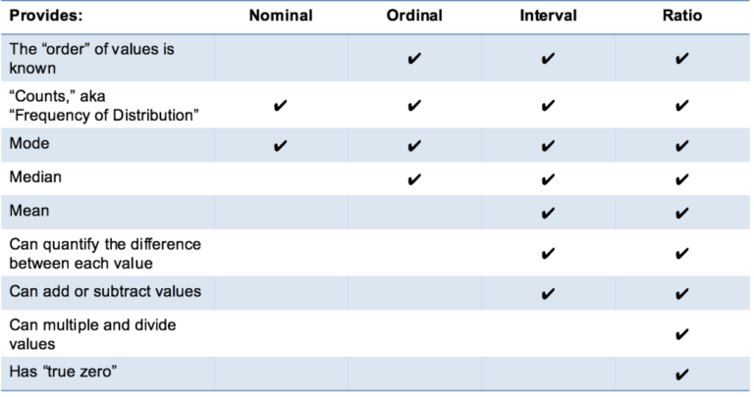
Summary of Data Types and Scale Measures
Source: https://www.mymarketresearchmethods.com/types-of-data-nominal-ordinal-interval-ratio/

Slide 13
Agenda
Data, Dataset, and Scales of Measurement
Data Collection
Working with CSV
Working with Rational Database
Working with HTML
Working with XML and JSON
Working with APIs

Slide 14
Data Collection for Data Science
Data collection is the first step in data science procedures.

Slide 15
Data Sources
Primary data: collect first-hand data through experimental or observational studies (e.g., survey)
Secondary data: reuse existing data
Database or data warehouse
Dataset collected by someone else
Data downloaded from organizations such as government agencies and industry associations
Digital trace data recorded by computer systems
Web server logs
Internet social media and user-generated content
In this course, we focus on the management and analysis of existing data

Slide 16
Major Contents to Cover
General principles for data management
Common data representation structures such as database, CSV, HTML, XML, JSON
Commonly used data collection methods

Slide 17
Common Data Collection Methods
CSV
Relational Database
XML and JSON
Web Scraping (copy and paste is inefficient)
HTML
API
Web scraping (web harvesting or web data extraction) is a computer software technique of extracting information from websites.
---- Wikipedia (https://en.wikipedia.org/wiki/Web_scraping)

Slide 18
Agenda
Data, Dataset, and Scales of Measurement
Data Collection
Working with CSV
Working with Rational Database
Working with HTML
Working with XML and JSON
Working with APIs

Slide 19
Working with CSV Files

Slide 20
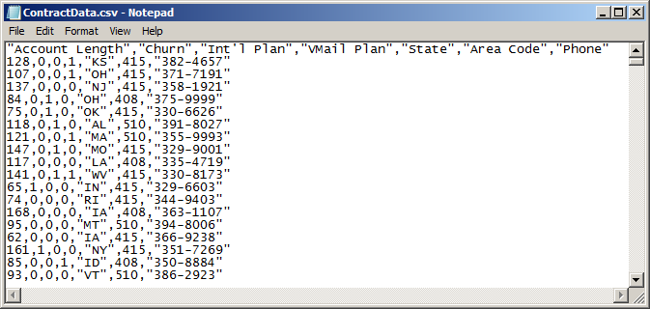
Comma Separated Values (CSV) Files
CSV is a widely used data exchange format. Nowadays many companies are still using CSV to share information with their customers and suppliers.
CSV files save tabular data in plain text.
Use comma (“,”) to separate data fields
May use the first line as a header containing field names
May use single or double quotation marks around some or all fields
Source: https://en.wikipedia.org/wiki/Comma-separated_values

Slide 21
Comments on CSV Files
A very simple design of CSV files is to use plain text to store tabular data.
CSV files can be easily read or written by using Notepad, MS Excel, and other software tools.
However, a plain text format is very difficult to store complicated data such as long textual data. Important format information may be lost.

Slide 22
R Code: Read and Write CSV Files
# Set working directory to the folder which contains the CSV file
setwd("D:\\Cloud\\Dropbox\\Teaching 2016 Fall\\IST 3420\\03.Data Basics")
# Read CSV file
call_data <- read.csv(file = "CallsData.csv", header = TRUE)
head(call_data)
summary(call_data)
# Another way is to use read.table() function
call_data2 <- read.table("CallsData.csv", header = TRUE, sep = ",")
head(call_data2)
summary(call_data2)
# Select Area Code and Phone number and combine them into a new list
phone <- cbind(call_data$Area.Code, as.character(call_data$Phone))
colnames(phone) <- c("AreaCode","PhoneNum")
# Write the phone data into csv file under the working directory
write.csv(phone, file = "Phone.csv")
# Write the phone data into a .txt file, using tab as field separator
write.table(phone, file = "Phone.txt", sep = "\t")
# Show all files under the working directory
dir()

Slide 23
Agenda
Data, Dataset, and Scales of Measurement
Data Collection
Working with CSV
Working with Rational Database
Working with HTML
Working with XML and JSON
Working with APIs

Slide 24
Working with Relational Database

Slide 25
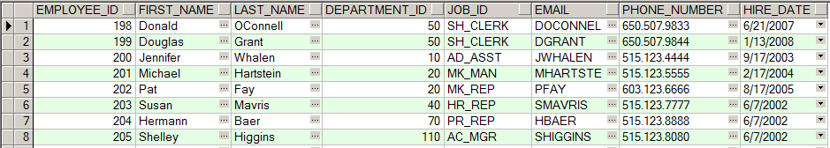
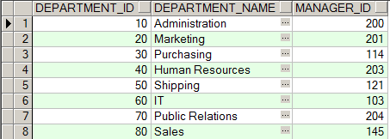
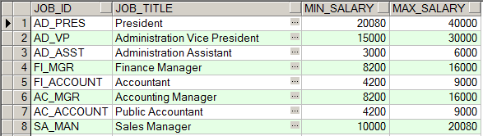
Relational Database
A relational database consists of a collection of related data tables
EMPLOYEE table
DEPARTMENT table
JOB table
Notes:
select t.employee_id, t.first_name, t.last_name, t.email, t.phone_number,t.hire_date from hr.employees t
select t.department_id, t.department_name, t.manager_id from hr.departments t
select * from hr.jobs t

Slide 26
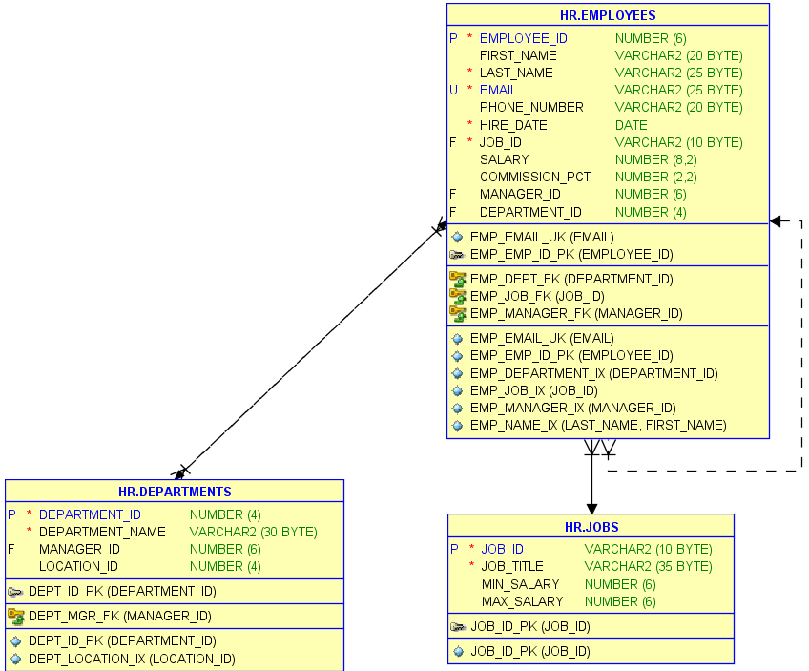
Entity Relationship Diagrams (ERD)
An ERD describes business entities and their relationships
Notes:
http://www.golinuxhub.com/2014/03/how-to-generate-er-diagram-using-oracle.html

Slide 27
Database Tables
A table is a collection of related data held in a structured format within a database. It consists of columns, and rows.
A column (aka attribute, or field) defies the characteristics of the data stored in the column
A row (aka record, or tuple) represents a single, implicitly structured data item
column
row

Slide 28
Structured Query Language (SQL)
A query language designed to manipulate data held in a relational DBMS
Initially developed at IBM in the early 1970s
Became a standard of the American National Standards Institute (ANSI) in 1986
Beyond the ANSI-standard SQL, variants are supported by different DBMS platforms
Oracle: PL/SQL
Microsoft SQL Server: Transact-SQL
IBM DB2: SQL PL
MySQL: SQL/PSM
Source: https://en.wikipedia.org/wiki/SQL

Slide 29
SQL Select Statement
SELECT is the most common operation in SQL.
SELECT retrieves data from one or more tables, or expressions.
Standard SELECT statements have no persistent effects on the database.
Syntax: SELECT {ColumnName(s)} FROM {TableName(s)} WHERE {Condition(s)}

Slide 30
An Example: Reading Data from SQLite
Using SQL is a critical skill for data scientists.
SQLite is a popular embedded RDBMS software for client/local storage.
Need to install RSQLite package.

Slide 31
Data
Telecommunication Service Data: Calls and Contracts
Calls Data (TTL 3333 records)
Contract Data(TTL 3333 records)
Attribute | Record1 | Record2 | Record3
VMail Message | 25 | 26 | 0
Day Mins | 265.1 | 161.6 | 243.4
Eve Mins | 197.4 | 195.5 | 121.2
Night Mins | 244.7 | 254.4 | 162.6
Intl Mins | 10 | 13.7 | 12.2
CustServ Calls | 1 | 1 | 0
Day Calls | 110 | 123 | 114
Day Charge | 45.07 | 27.47 | 41.38
Eve Calls | 99 | 103 | 110
Eve Charge | 16.78 | 16.62 | 10.3
Night Calls | 91 | 103 | 104
Night Charge | 11.01 | 11.45 | 7.32
Intl Calls | 3 | 3 | 5
Intl Charge | 2.7 | 3.7 | 3.29
Area Code | 415 | 415 | 415
Phone | 382-4657 | 371-7191 | 358-1921
Attribute | Record1 | Record2 | Record3
Account Length | 128 | 107 | 137
Churn | 0 | 0 | 0
Int'l Plan | 0 | 0 | 0
VMail Plan | 1 | 1 | 0
State | KS | OH | NJ
Area Code | 415 | 415 | 415
Phone | 382-4657 | 371-7191 | 358-1921

Slide 32
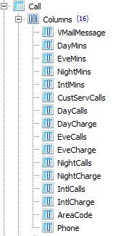
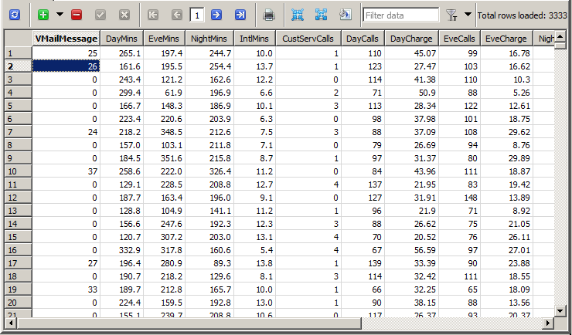
SQLite Structure
Table Call

Slide 33
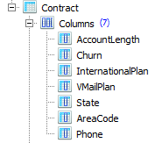
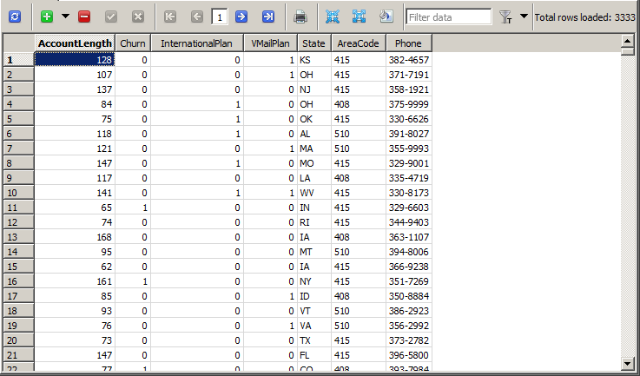
(cont.)
Table Contract

Slide 34
R Code: Read from SQLite
# If you haven't installed RSQLite package, do it.
install.packages("RSQLite")
library("RSQLite")
# Set working directory to the folder which contains the SQLite database file
setwd("D:\\Cloud\\Dropbox\\Teaching 2016 Fall\\IST 3420\\03.Data Basics")
# Specify the database file
dbfile <- "TelecomService.sqlite"
# Create a database connection
con <- dbConnect(dbDriver("SQLite"), dbname = dbfile)
# Get call data
call_data <- dbGetQuery(con, "SELECT * FROM Call")
head(call_data)
summary(call_data)
# Get contract data
contract_data <- dbGetQuery(con, "SELECT * FROM Contract")
head(contract_data)
summary(contract_data)

Slide 35
Agenda
Data, Dataset, and Scales of Measurement
Data Collection
Working with CSV
Working with Rational Database
Working with HTML
Working with XML and JSON
Working with APIs

Slide 36
Working with HTML

Slide 37
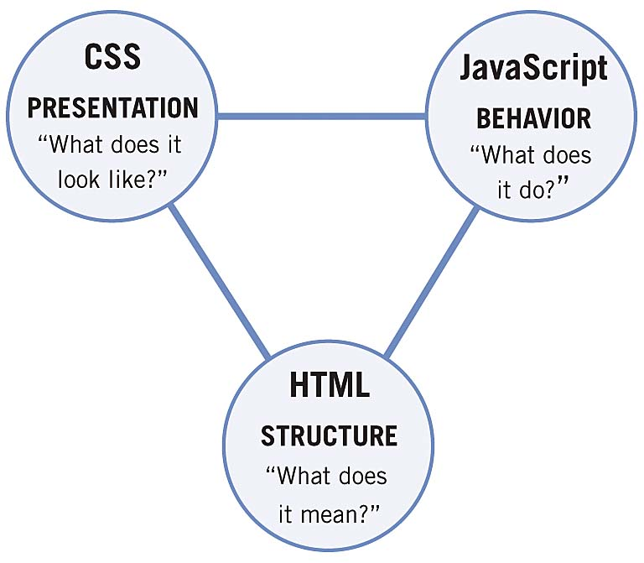
HTML Overview
HyperText Markup Language (HTML) is the standard markup language used to create web pages.
Web Application = HTML + CSS + JavaScript
HTML: Content and structure of web pages
Headings
Paragraphs
Lists
Images...
CSS (Cascading Style Sheets): Describe the presentation/display of HTML elements
Font
Color
Border...
JavaScript: Control the behavior of HTML elements
User interaction
Button click
Dynamic display
Image source: https://melaloo.files.wordpress.com/2015/07/02fig01.jpg
Notes:
HTML, CSS, and JavaScript are three cornerstone technology for web applications.

Slide 38
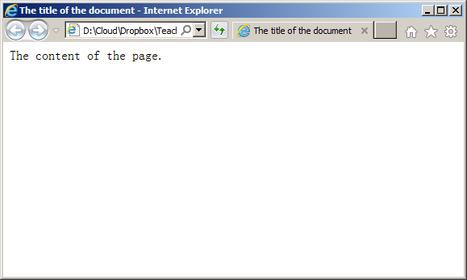
A Simple HTML Page: A Tree Structure
SimpePage.html
Contents are stored within tags
<!DOCTYPE html>
<html>
<head>
<title>The title of the document</title>
</head>
<body>
The content of the page.
</body>
</html>

Slide 39
URL
A Uniform Resource Locator (URL) is an identifier which specifies the location of a web resource
Web pages (http, https)
Email (mailto)
FTP
Database connection
A web page URL
http://www.mst.edu/index.html
protocol
host name
file location and name

Slide 40
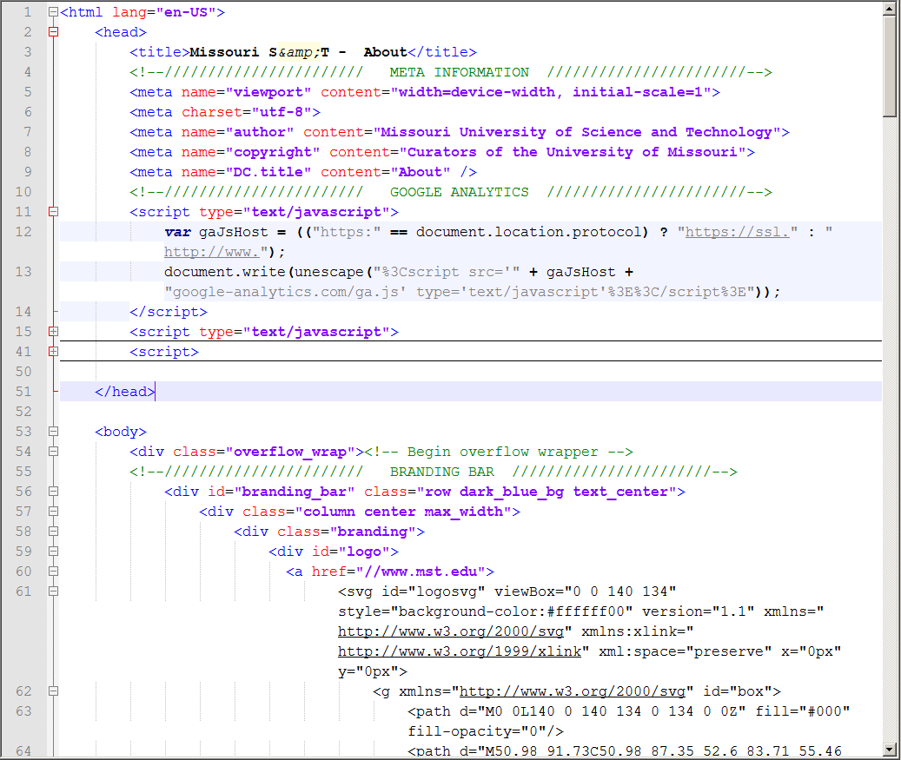
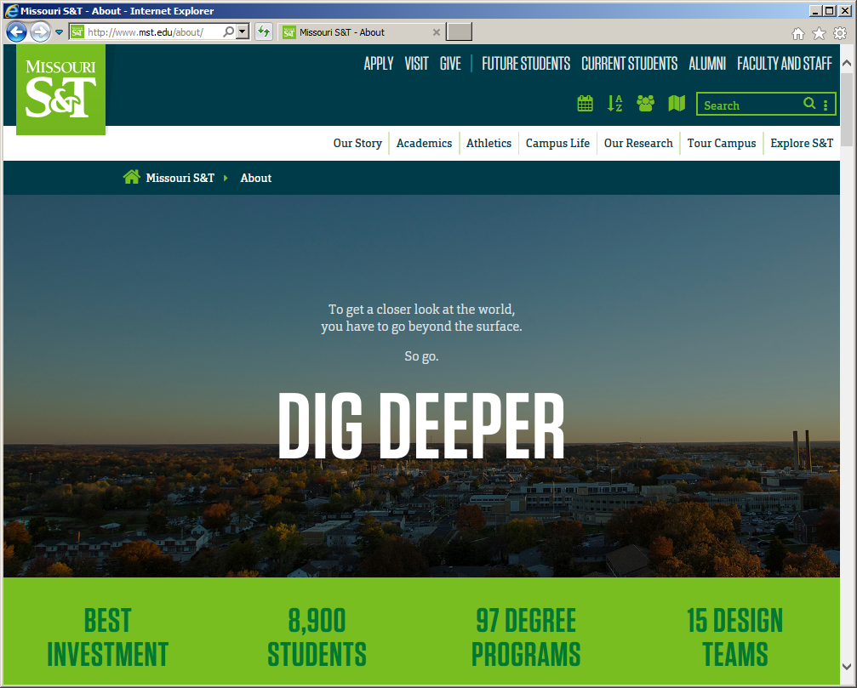
In Practice...
HTML with CSS and JavaScript becomes complicated
http://www.mst.edu/about/

Slide 41
Interest in Data Science
Our objective is to get data of interest from the complicated web page structure.
Usually we can ignore all CSS and JavaScript parts.

Slide 42
Guidelines for Web Data Collection
Inspect the website to fully understand the web page structure and content
Some important packages in R
RCurl (not well-maintained)
XML
httr
Steps in scraping web pages
Specify URL
Get the web page content
Parse the web page content
Read specific elements in the web page

Slide 43
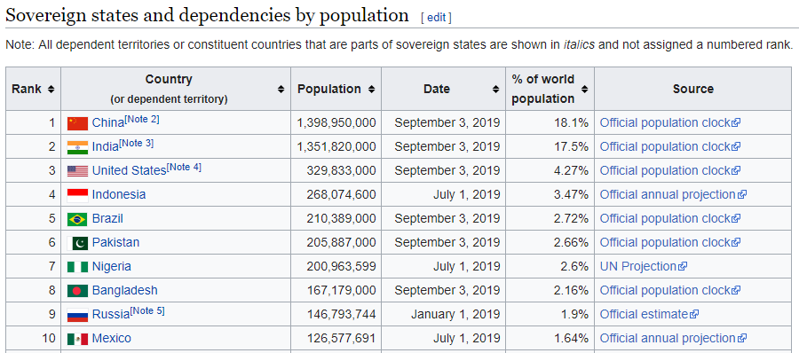
Example: Scraping Tables from Web Pages
Task: To collect world population data from the following Wikipedia web page https://en.wikipedia.org/wiki/List_of_countries_and_dependencies_by_population

Slide 44
HTML Table Tags
Tag | Description
<table> | Defines a table
<caption> | Defines a table caption
<th> | Defines a header cell in a table
<tr> | Defines a row in a table
<td> | Defines a cell in a table
<thead> | Groups the header content in a table
<tbody> | Groups the body content in a table
<tfoot> | Groups the footer content in a table
<col> | Specifies column properties for each column within a <colgroup> element
<colgroup> | Specifies a group of one or more columns in a table for formatting
For a description of complete HTML tags, refer to: http://www.w3schools.com/tags/ref_byfunc.asp

Slide 45
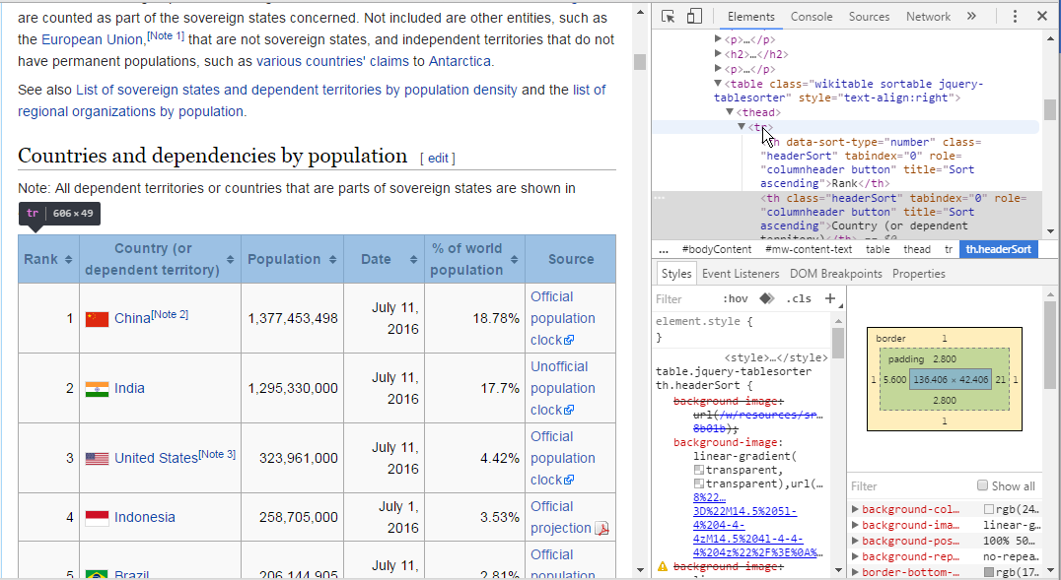
Inspect the Tree Structure of Web Page
In Google Chrome, right click the table and then select “Inspect” menu.
Then move mouse over the HTML element, the corresponding display content will be highlighted.

Slide 46
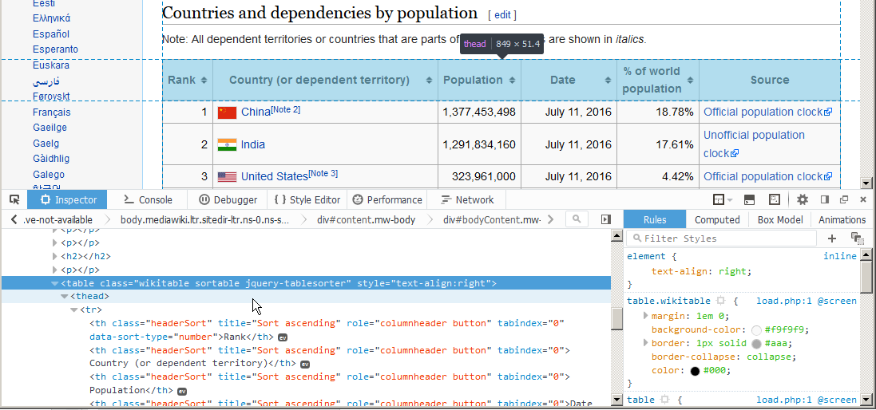
(cont.)
In Firefox, right click the table and then select “Inspect Element” menu.
Then move mouse over the HTML element, the corresponding display content will be highlighted.

Slide 47
R Code: Scraping Tables from Web Pages
# Load packages
library("XML")
library(“httr")
# Specify URL
url <- "https://en.wikipedia.org/wiki/List_of_countries_and_dependencies_by_population"
# Download the content of the URL
url_content <- GET(url)
# Parse the HTML/XML content to generate an R structure representing the HTML/XML tree
doc <- htmlParse(url_content)
tables <- readHTMLTable(doc)
# Convert the 1st element of the list to data frame
pop_df <- data.frame(tables[1])
attributes(pop_df)
colnames(pop_df) <- c("Rank","Country/Territory","Population","Date","% of World Population","Source")
is.factor(pop_df$Population)
# Convert factors into numbers for Population column
pop_df$Population <- as.numeric(gsub(",","",pop_df$Population))
top10 <- head(pop_df, n = 10L)
plot(top10$Population, type = "l")

Slide 48
Agenda
Data, Dataset, and Scales of Measurement
Data Collection
Working with CSV
Working with Rational Database
Working with HTML
Working with XML and JSON
Working with APIs

Slide 49
Working with XML and JSON

Slide 50
HTML vs XML vs JSON
GML (Generalized Markup Language): developed in the 1960’s by three IBM employees for digitization of documents and limited processing power.
Solution: wrapping tags around the content that would define both the structure and formatting of the content inside the tags.
SGML (the standardized version of GML): produced a great result (reader-friendly documents)
Issue: too many rules to be followed or else the whole process would not work.
HTML: just like SGML, HTML wraps content in tags, but unlike it, the rules regarding which tags could be used when and where were much less strict.
Issue: the lack of structure provided by SGML was still missing.
XML: maintaining all the strict rules of SGML, therefore maintaining the structure of information (just as a database does), without worrying about the formatting at all (this was left up to the HTML to address).
JSON: more popular than XML nowadays due to the advancement of web application development (think dynamic vs static websites). It also requires less coding and has a smaller size, making it faster to process and transmit data.
https://medium.com/@oazzat19/what-is-the-difference-between-html-vs-xml-vs-json-254864972bbb

Slide 51
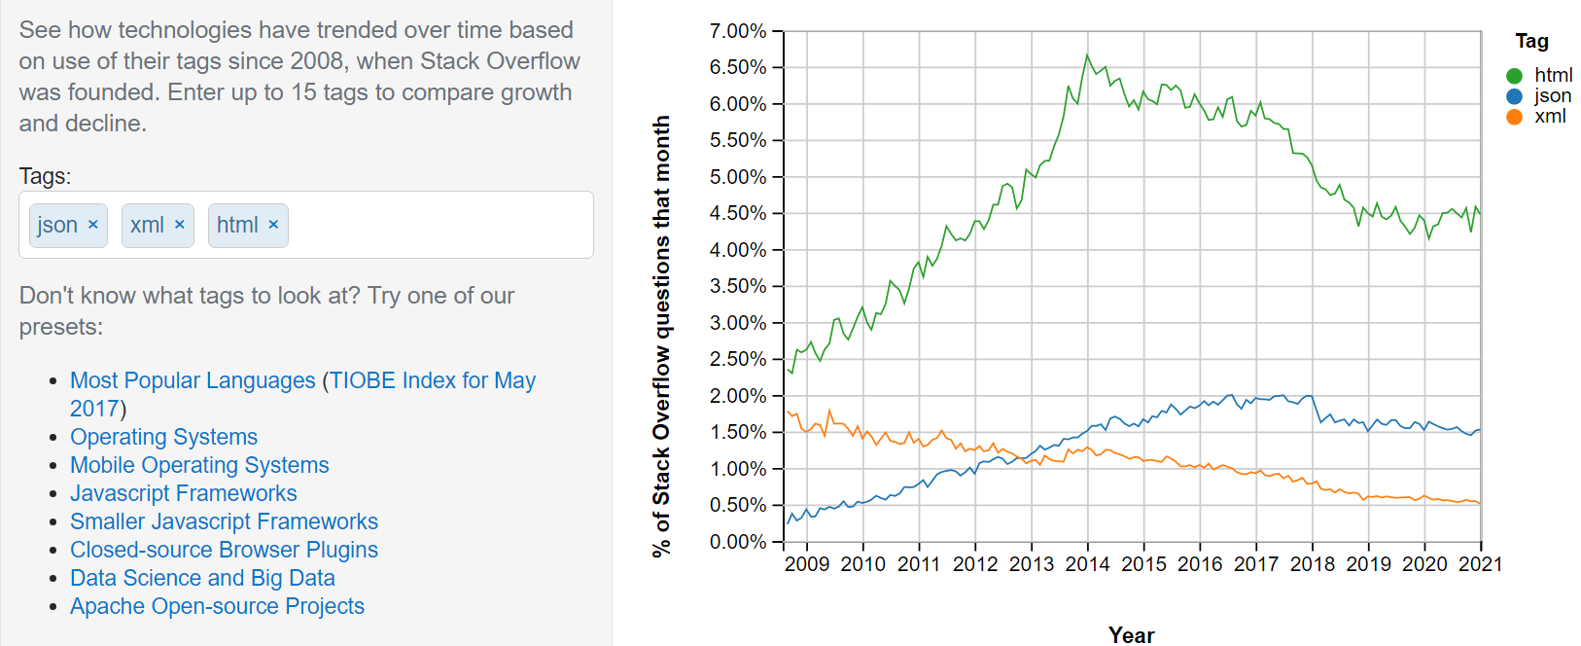
Stack Overflow Trends
https://insights.stackoverflow.com/trends?tags=json%2Cxml%2Chtml

Slide 52
What is XML?
XML stands for EXtensible Markup Language
XML is a markup language much like HTML
XML was designed to store and transport data (platform independent)
Exchanging data between incompatible systems (or upgraded systems) is a time-consuming task for web developers. Large amounts of data must be converted, and incompatible data is often lost.
XML stores data in plain text format. This provides a software- and hardware-independent way of storing, transporting, and sharing data.
Easier to expand or upgrade to new operating systems, new applications, or new browsers, without losing data.
With XML, data can be available to all kinds of "reading machines" like people, computers, voice machines, news feeds, etc.
XML separates data from presentation
XML is a W3C (World Wide Web Consortium) recommendation since 1998
Source: http://www.w3schools.com/xml/xml_whatis.asp

Slide 53
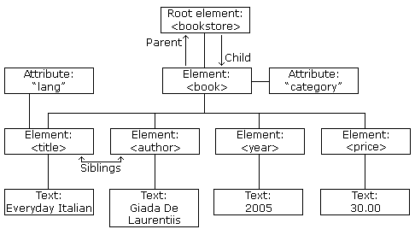
An XML File: Element + Attribute + Text
Books.xml
<?xml version="1.0" encoding="UTF-8"?>
<bookstore>
<book category="cooking">
<title lang="en">Everyday Italian</title>
<author>Giada De Laurentiis</author>
<year>2005</year>
<price>30.00</price>
</book>
<book category="children">
<title lang="en">Harry Potter</title>
<author>J K. Rowling</author>
<year>2005</year>
<price>29.99</price>
</book>
<book category="web" cover="paperback">
<title lang="en">Learning XML</title>
<author>Erik T. Ray</author>
<year>2003</year>
<price>39.95</price>
</book>
</bookstore>
XML Tree Structure
Source: http://www.w3schools.com/xml/default.asp

Slide 54
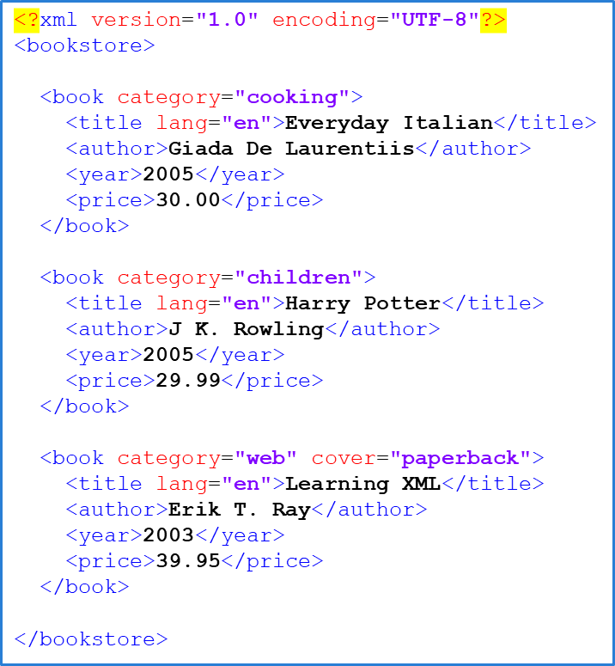
Summary of XML Syntax
An XML tree starts at a root element and branches from the root to child elements.
XML prolog is optional
<?xml version="1.0" encoding="UTF-8"?>
Elements must have a closing tag
Tags are case sensitive
Elements must be properly nested within each other
Attributes must be quoted
Source: http://www.w3schools.com/xml/xml_syntax.asp

Slide 55
XML vs. HTML
XML does not carry any information on data presentation
You define your own XML tag!
XML is a complement to HTML
Many web applications use XML to store or transport data, while using HTML to display the same data
Thousands of XML formats exist, in many different industries, to describe day-to-day data transactions:
Financial transactions
Medical data
News information
Weather services

Slide 56
XPath
XPath stands for the XML Path Language,
Use XPath to extract information from XML documents
XPath uses path expressions to select nodes or node-sets in XML documents
These path expressions look very much like the expressions you see when you work with a traditional computer file system.
To learn more about XPath, go to: https://www.w3schools.com/xml/xpath_intro.asp

Slide 57
Some XPath expressions
XPath Expression | Result
/bookstore/book | Selects all book elements that are children of bookstore
/bookstore/book[1] | Selects the first book element that is the child of the bookstore element
/bookstore/book[last()] | Selects the last book element that is the child of the bookstore element
/bookstore/book[position()<3] | Selects the first two book elements that are children of the bookstore element
//@lang | Selects all attributes that are named lang
//title[@lang] | Selects all the title elements that have an attribute named lang
//title[@lang='en'] | Selects all the title elements that have a "lang" attribute with a value of "en"
/bookstore/book[price>35.00] | Selects all the book elements of the bookstore element that have a price element with a value greater than 35.00
/bookstore/book[price>35.00]/title | Selects all the title elements of the book elements of the bookstore element that have a price element with a value greater than 35.00
<?xml version="1.0" encoding="UTF-8"?>
<bookstore>
<book category="cooking">
<title lang="en">Everyday Italian</title>
<author>Giada De Laurentiis</author>
<year>2005</year>
<price>30.00</price>
</book>
<book category="children">
<title lang="en">Harry Potter</title>
<author>J K. Rowling</author>
<year>2005</year>
<price>29.99</price>
</book>
<book category="web" cover="paperback">
<title lang="en">Learning XML</title>
<author>Erik T. Ray</author>
<year>2003</year>
<price>39.95</price>
</book>
</bookstore>

Slide 58
R Code: Read XML Data
require(XML)
# Specify XML file location
loc <- "D:\\Cloud\\Dropbox\\Teaching 2016 Fall\\IST 3420\\3.Data Basics\\Books.xml"
doc <- xmlParse(file = loc) # Parse XML file to generate an R structure
top <- xmlRoot(doc) # Get the root node
# Explore root node
xmlName(top)
names(top) # Show child nodes of the root node
names(top[[1]]) # Show child nodes of the 1st book
top[[1]][["title"]] # Show tile of the 1st book
top[[1]][["year"]] # Show year of the 1st book
top[[1]][["price"]] # Show price of the 1st book
# Use xpathSApply() to extract information by XPath expression.
# The xpathSApply() is a simplified version of xpathApply() function.
b_tile <- xpathSApply(doc,"//bookstore/book/title", xmlValue)
b_category <- xpathSApply(doc,"//bookstore/book/@category")
b_author <- xpathSApply(doc,"//bookstore/book/author", xmlValue)
b_year <- xpathSApply(doc,"//bookstore/book/year", xmlValue)
b_price <- xpathSApply(doc,"//bookstore/book/price", xmlValue)
# Generate a book data frame
book_df <- data.frame(b_tile,b_category,b_author,b_year,b_price)
colnames(book_df) <- c("Tile","Category","Author","Year","Price")
print(book_df)

Slide 59
What is JSON?
JSON stands for JavaScript Object Notation, an open-standard format of expressing information.
A JSON document consists of attribute–value pairs.
JSON is promoted as a low-overhead alternative to XML.
Though JSON is named after JavaScript language, it is language independent.
Many programming languages support JSON.

Slide 60
JSON vs XML
JSON is Like XML Because
Both JSON and XML are "self describing" (human readable)
Both JSON and XML are hierarchical (values within values)
Both JSON and XML can be parsed and used by lots of programming languages
Both JSON and XML can be fetched with an XMLHttpRequest
JSON is Unlike XML Because
JSON doesn't use end tag
JSON is shorter
JSON is quicker to read and write
JSON can use arrays
XML has to be parsed with an XML parser. JSON can be parsed by a standard JavaScript function.

Slide 61
JSON Syntax
Books.json
Data is in name/value pairs (separated by colon)
Data is separated by commas
Curly braces hold objects
Square brackets hold arrays
{ "Tile":[ "Everyday Italian", "Harry Potter", "Learning XML" ], "Category":[ "cooking", "children", "web" ], "Author":[ "Giada De Laurentiis", "J K. Rowling", "Erik T. Ray" ], "Year":[ "2005", "2005", "2003" ], "Price":[ "30.00", "29.99", "39.95" ] }
Source: https://www.w3schools.com/js/js_json_intro.asp

Slide 62
R Code: Access JSON Data
Use rjson package
toJSON() : Convert R to JSON
fromJSON() : Convert JSON to R
Note: Use the same data frame object created by XML example
# Load rjson package
require(rjson)
# Convert data frame to JSON
# data.frames must be converted into a list before converting into JSON
j_book <- toJSON(as.list(book_df))
print(j_book)
# Convert JSON to data frame
book_df2 <- data.frame(fromJSON(j_book))
print(book_df2)

Slide 63
Agenda
Data, Dataset, and Scales of Measurement
Data Collection
Working with CSV
Working with Rational Database
Working with HTML
Working with XML and JSON
Working with APIs

Slide 64
Working with APIs

Slide 65

Application Programming Interface (API)
An API is a (hypothetical) contract between two softwares
Graphical user interface (GUI) allows humans to interact with code, while API allows one piece of code to interact with other code
Widely used by developers for implementing various features instead of coding it by themselves
e.g. Pokémon Go
Source: https://www.analyticsvidhya.com/blog/2016/11/an-introduction-to-apis-application-programming-interfaces-5-apis-a-data-scientist-must-know/

Slide 66
Three primary elements of API
Access: is the user or who is allowed to ask for data or services?
Request: is the actual data or service being asked for (e.g., if I give you current location from my game (Pokemon Go), tell me the map around that place). A Request has two main parts:
Methods: i.e. the questions you can ask, assuming you have access (it also defines the type of responses available).
Parameters: additional details you can include in the question or response.
Response: the data or service as a result of your request.

Slide 67
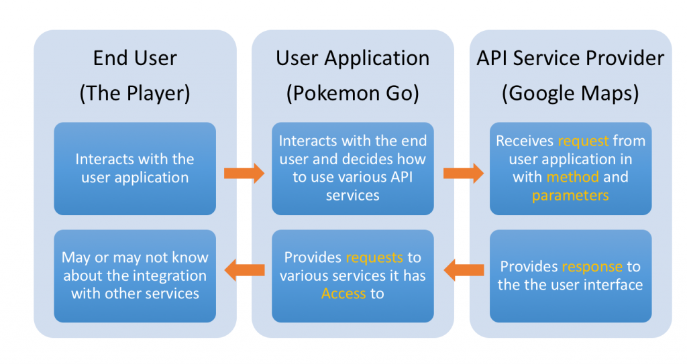
Three primary elements of API – Pokémon Go example

Slide 68
Some data science projects using API
Social Media Sentiment Analysis: By using data from Twitter and Facebook API.
Opinion Mining: By using data from Twitter and Facebook API.
Stock Prediction: By using data from Yahoo Stock API and Quandl API.
Most Popular languages on Github: By using data from Github API.
Microsoft Face Sentiment Recognition: By using Microsoft face API.

Slide 69
Pros and Cons of APIs
APIs are a robust way to integrate applications
For example, pull 5 latest tweets from a user through Twitter API and irrespective of changes happening at the front end of Twitter
When using web scrapping, you would need to make changes with every change in web site layout
Twitter may throw an advertisement in between the last 5 tweets and you need to filter it out
APIs might come with a limit on usage
Daily limits, number of requests in a time frame. To ensure that the servers of the service providers are under predictable loads
Paid access or keys are needed

Slide 70
Working with APIs through R
Some Web Applications provide APIs for access their content.
APIs usually accept HTTP request.
We already learn how to access XML and JSON files. Usually the XML and JSON objects are returned by APIs.
Some APIs
YouTube API
Google Maps API
Twitter API
Facebook API
Steam Web API
...

Slide 71
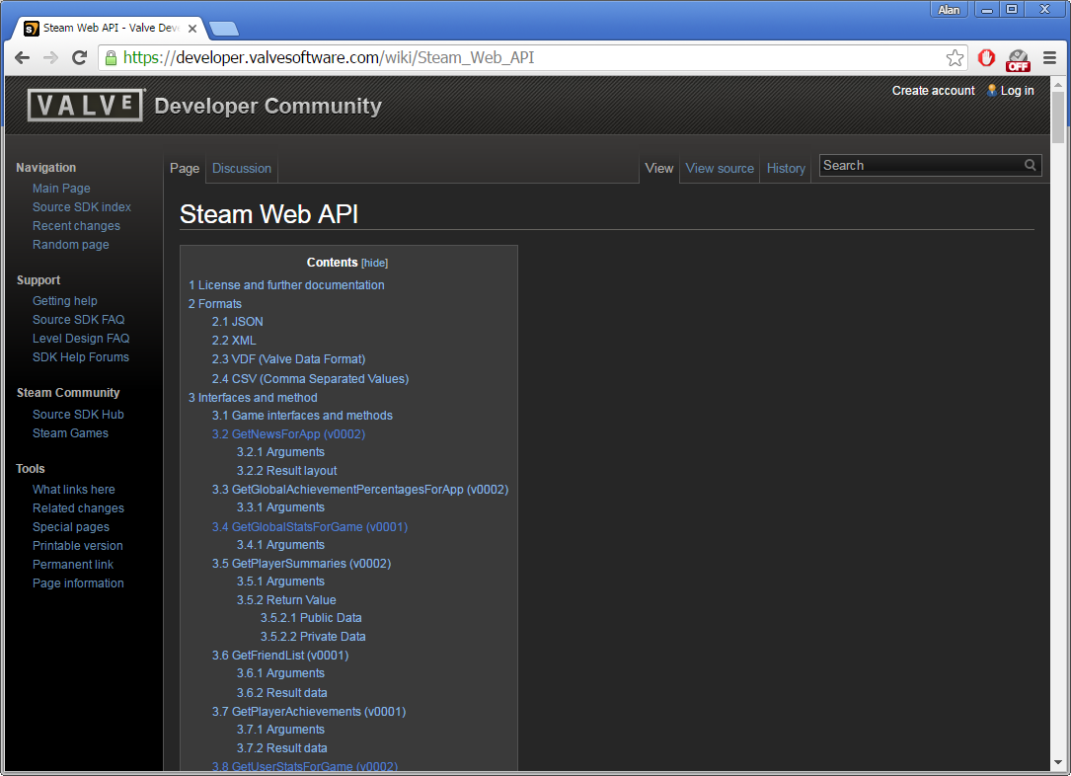
Steam Web API Specification
https://developer.valvesoftware.com/wiki/Steam_Web_API

Slide 72
GetNewsForApp (v0002)
GetNewsForApp returns the latest news of a game specified by its appID.
Example URL
http://api.steampowered.com/ISteamNews/GetNewsForApp/v0002/?appid=271590&count=3&maxlength=300&format=json
Arguments
appid: AppID of the game you want the news of.
count: How many news entries you want to get returned.
maxlength: Maximum length of each news entry.
format: Output format. json (default), xml or vdf.
Result layout
An appnews object containing:
appid, the AppID of the game you want news of
newsitems, an array of news item information:
An ID, title and url.
A shortened excerpt of the contents (to maxlength characters), terminated by "..." if longer than maxlength.
A comma-separated string of labels and UNIX timestamp.

Slide 73
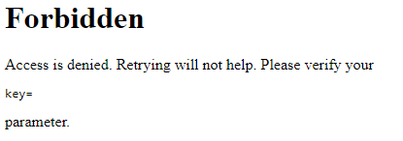
GetPlayerSummaries (v0002)
GetPlayerSummaries returns basic profile information for a list of 64-bit Steam IDs.
Example URL
http://api.steampowered.com/ISteamUser/GetPlayerSummaries/v0002/?key=XXXXXXXXXXXXXXXXXXXXXXX&steamids=76561197960435530
Arguments
steamids: Comma-delimited list of 64 bit Steam IDs to return profile information for. Up to 100 Steam IDs can be requested.
format: Output format. json (default), xml or vdf.
Result layout
steamid: 64bit SteamID of the user
personaname: The player's persona name (display name)
profileurl: The full URL of the player's Steam Community profile.
…
Key is needed to send request

Slide 74
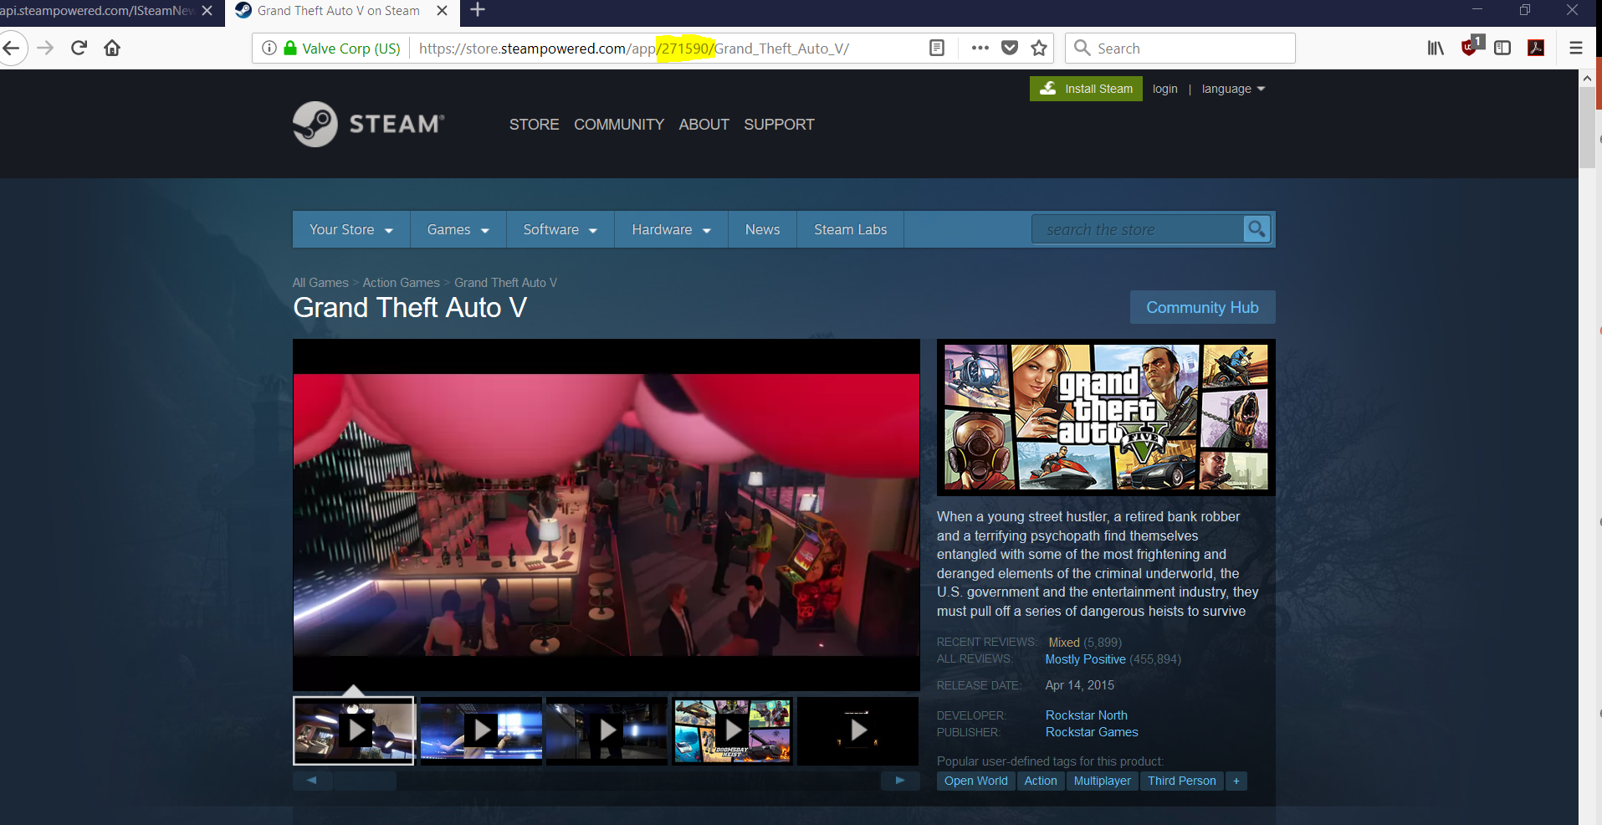
What is an App ID?
Select an App from steam store (http://store.steampowered.com/) to check it’s App ID

Slide 75
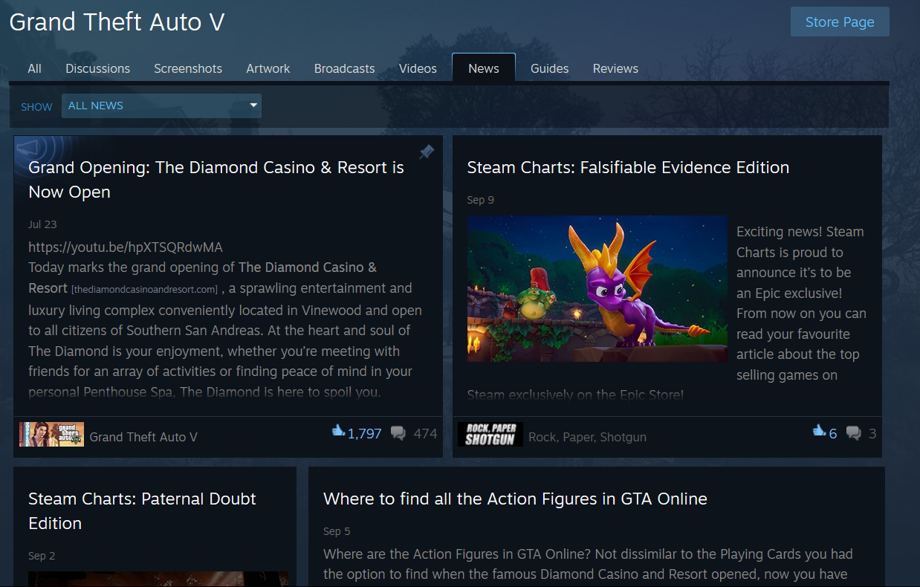
What data the API provides?
https://steamcommunity.com/app/271590/allnews/

Slide 76
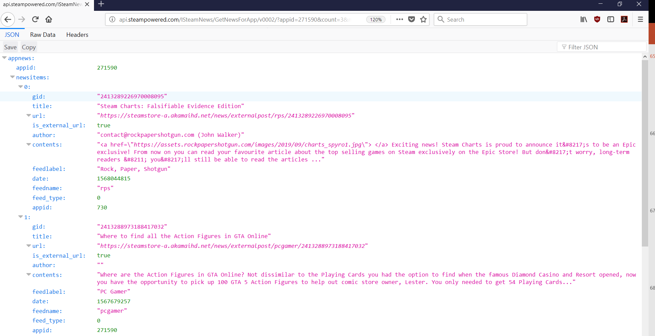
You can test the API in browsers
http://api.steampowered.com/ISteamNews/GetNewsForApp/v0002/?appid=271590&count=20&maxlength=300&format=json

Slide 77
R Code
appid <- 271590 # Choose Grand Theft Auto V whose App ID is 271590
n_new <- 100 # Number of news to get
# Generate url for the app
url <- paste("http://api.steampowered.com/ISteamNews/GetNewsForApp/v0002/?appid=", appid, "&count=", n_new, "&maxlength=300&format=json", sep = "")
# Download HTTP response
content = RCurl::getURI(url)
# Create a list
list <- fromJSON(content)
# Show content in the list
list$appnews$newsitems
list$appnews$newsitems[[1]]
# Create a data frame
df <- data.frame(matrix(unlist(list$appnews$newsitems), nrow = n_new, byrow=T))
# Rename variables in the data frame
colnames(df) <- names(json$appnews$newsitems[[1]])
# Show content of the data frame. You'll notice that the date is shown as numbers (in strings actually)
df
# Add variable date2 to show the readable date time
df$date2 <- as.POSIXlt(as.numeric(as.character(df$date)),origin = "1970-01-01")
df

Slide 78
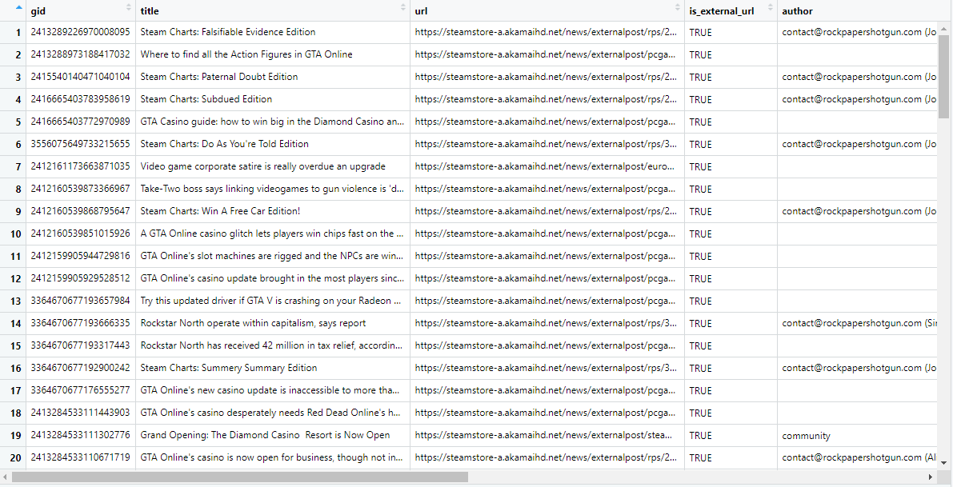
Dataset Collected
Data collected on 9/12/2019

Slide 79
Reading Assignment
Base R Cheat Sheet
https://www.rstudio.com/wp-content/uploads/2016/09/r-cheat-sheet-1.pdf
Data Transformation with dplyr
https://github.com/rstudio/cheatsheets/blob/master/data-transformation.pdf

Slide 80
Q & A

